Slide 1

Project Name- Ovarian Cyst/Tumor detector
Tea m Mem ber Samrat Bose

Slide 2
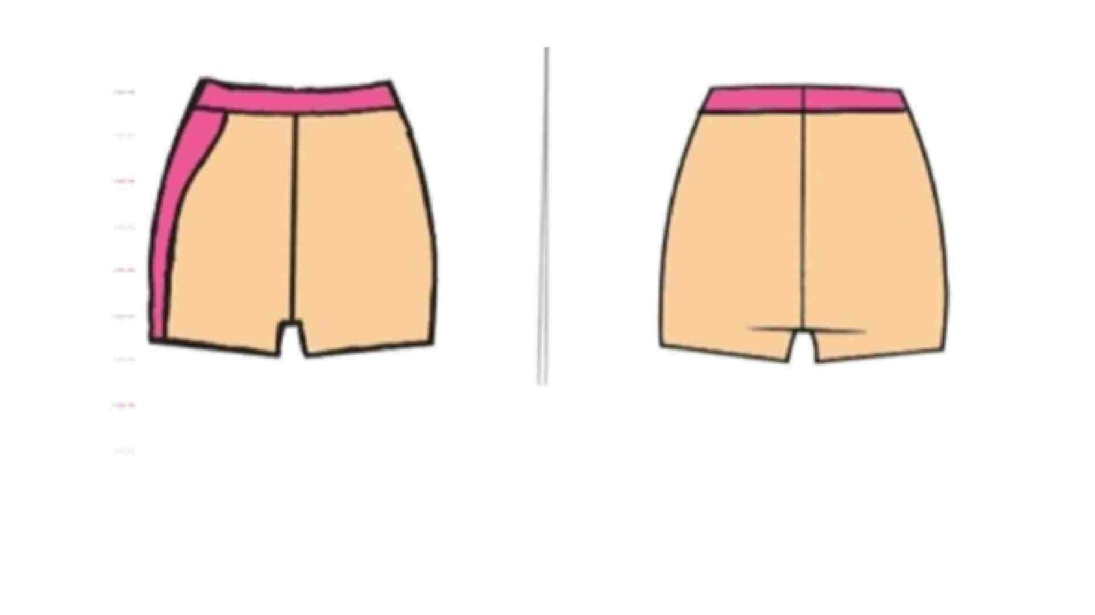
S HORTS

Slide 3

ACCORDING TO AIIMS " 20% TO 25% ARE SUFFERI
FRO M THE SYNDROME.
NUM BER OFWOMEN IN IND IA = 689,608,04 5
20% OF 689,608,04 5= 13,79,21,6 0 9
25% OF 689,608,045= 17,24,02,011
A PPROX

Slide 4
INTRODUCTION
The follicle contains fluid that protects the egg as it grows, and it bursts when the egg
released. But sometimes a follicle does not release an egg, or does not discharge its flu
and shrink after the egg is released. If this happens, the follicle can swell and become a cys
Sometimes ovarian cysts can convert into ovarian tumors or ovarian cancers. Because o
this woman face difficulties in their menstrual cycle, hormonal imbalance, complications
pregnancy and some more. We want to create an ovarian cysts/tumors detector cyclin
shorts.
STATEMENT
Cycling shorts being a good coverage of the women lower body could help to detect ever
moment and any change in the lower part of the body.

Slide 5
OBJECTIVE
Late diagnosis sometimes causes deaths. If they are aware of this it could resolve complication
We want to make our product capable of detecting cysts or tumors in early stage so that wome
could get it diagnosed early. Cycling shorts are easy to wear and comfortable. We want to make ou
product helpful for all the girls and the women all over the world.

Slide 6
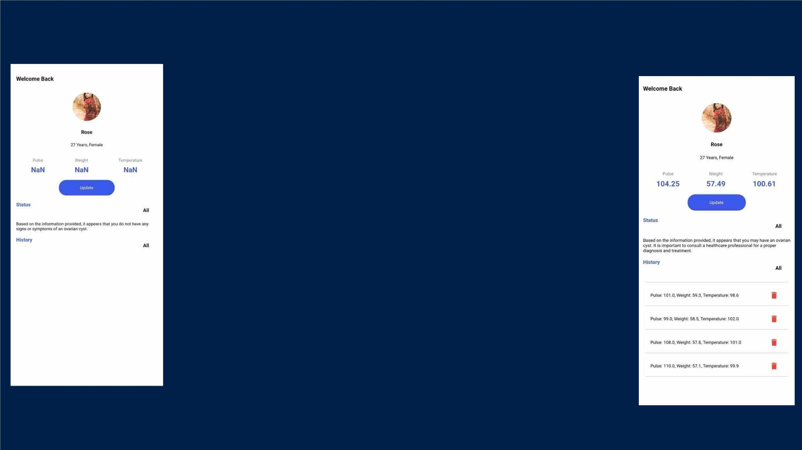
HOW OUR APP WORKS?
First, we have to manually add the data to the app. After
one month the app will give you a average data of last
month. The app will then recommend you on the basis of
your data whether you should visit the doctor for further
checkup or not.
- AFTER GETTI NG D ATA-

Slide 7
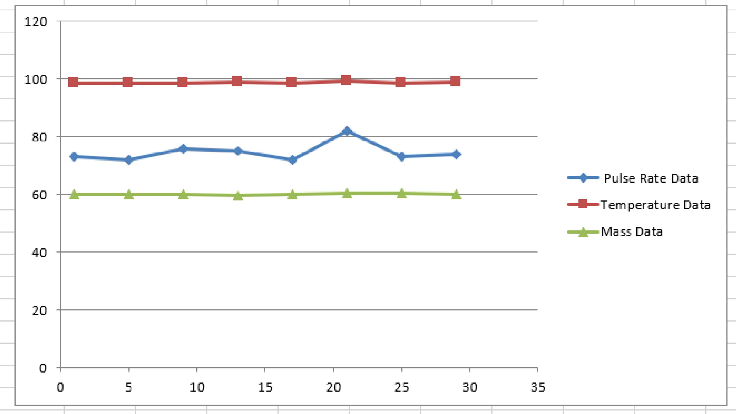
PERSON
W ITH THE
HEALTHY
OVARY

Slide 8
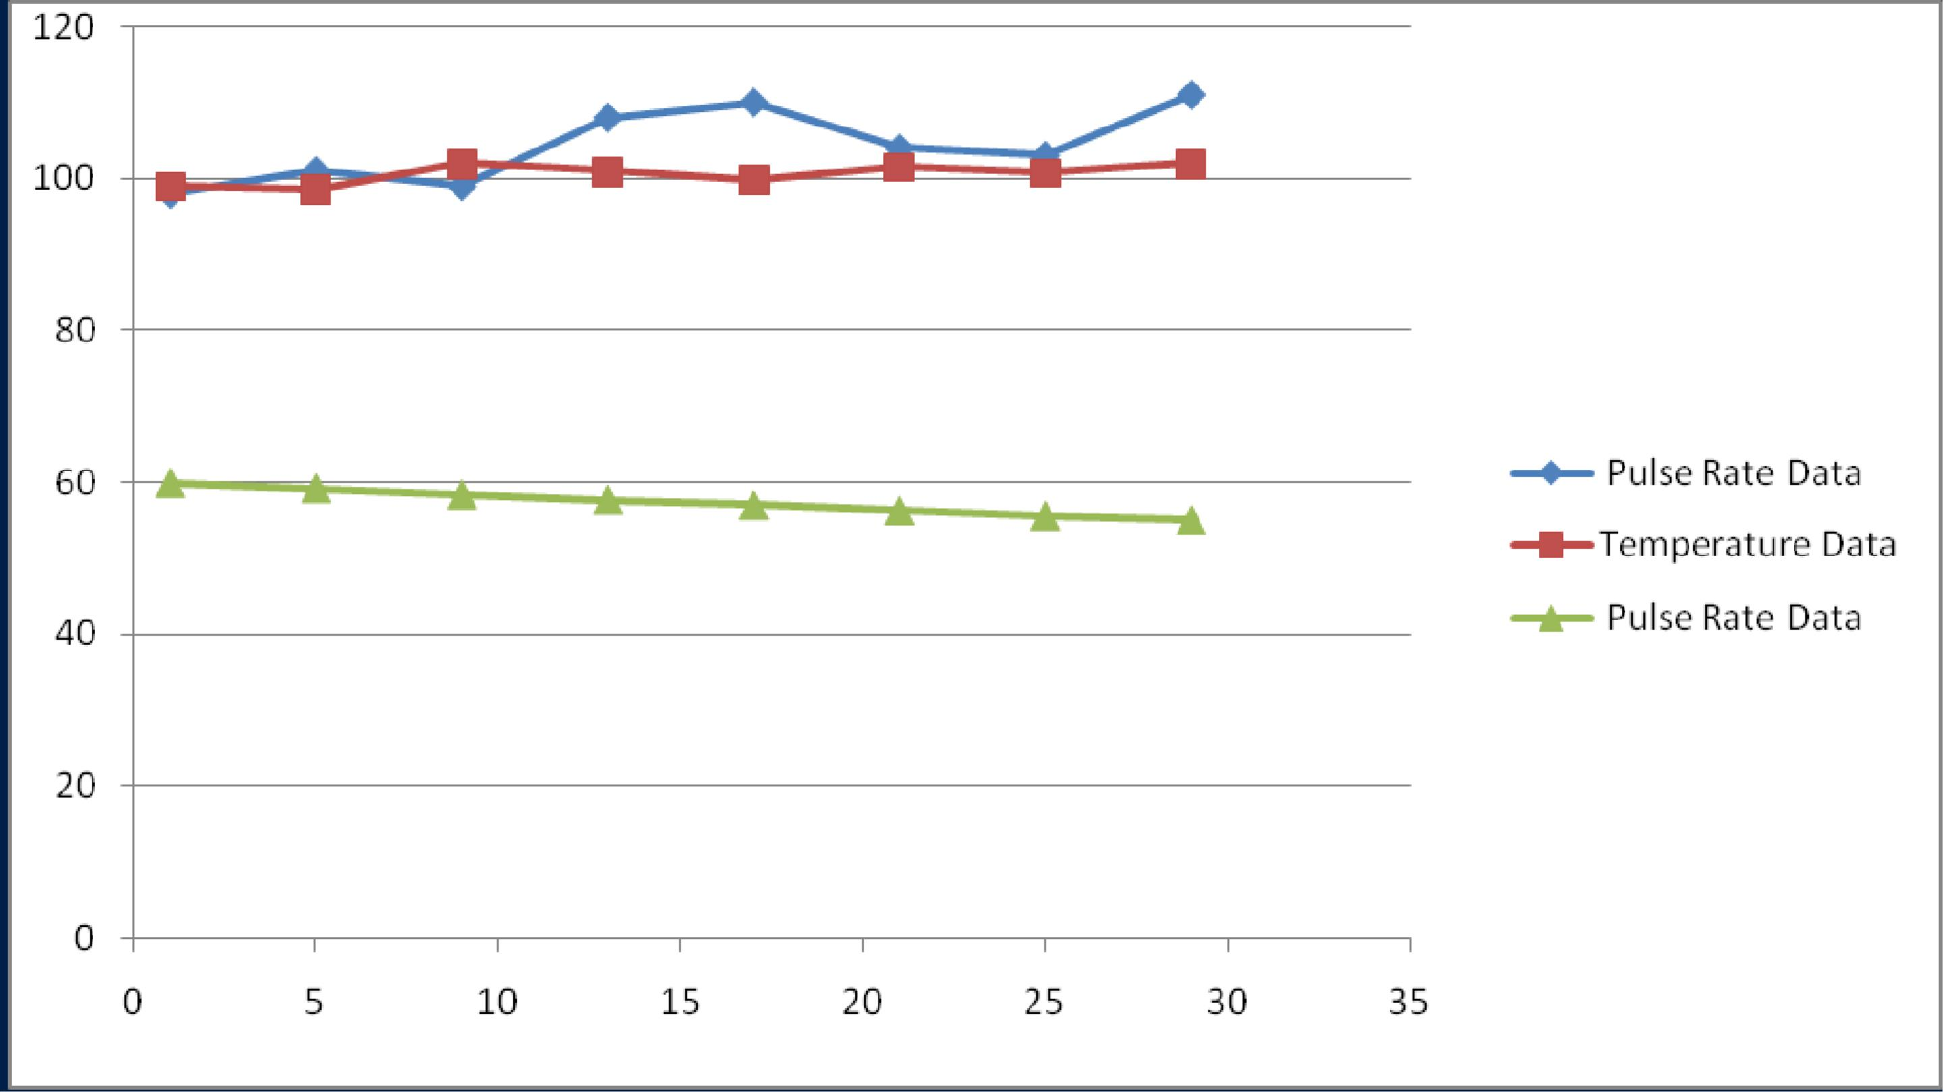
PERSON WITH
AN OVARI AN
CYST

Slide 9
US ES AND P RECAUTI ON
A woman should have to wear this shorts for 2-3 hours twice a week for better results. Whi
wearing this shorts there should not be a lot of physical change in the body i.e. They will no
wear this shorts while doing exercise. They will not wear this short when their menstrual cycle
going on because it could lead to false alarm. This product shouldn't be washed in the washin
machine, wash this product in the interval of 1month. Don’t soak the product in the water fo
more than 1 hour it could damage the product. While washing the product don't rub it harsh
and try not to squeeze the product a lot after washing and don’t dry the product in the washin
machine.

Slide 10

COST ANALYSIS
Arduino Nano-
Bluetooth Module (HC-05)-
Pulse rate sensor-
₹3
₹
₹
(MLX 90614)Temperature Sensor-
₹
Cycling Shorts-
₹
TOTAL-
₹1635

Slide 11

OBS ERVATION AND CONCLUS ION
We know that late diagnosis could led to death and on general basis ovarian cysts
rarely have symptoms, this product could help women get to know about their
medical state and let them know if any kind of problem are having with them. If we
will be able to make this project and launch it to the market it would be very useful for
the women. Through the chart give below, we can conclude that late diagnosis
causes deaths. Most of the women wear cycling shorts on daily basis so if they will
wear this short for 2-3 hours twice a week it would be beneficial for their own health.
We could help women all over the world through this product. We know that this is
just a little c ontrib ution but it d oes ha ve a va st effec t.

Slide 12
FUTUR E AS PECT
We want to take our product on international level so that every single woman could use ou
product and led a healthy life. Our project is a bit time taking because there are a lot mor
sensors and this is a medical related project so there will be a lot of precautions. If our produ
launched to an international level, we would not be able to earn a lot profit at the beginning a
we have to establish our brand, after our brand is established in the market, we would still tr
not to sell the product in a very high price, the price will be moderate so that people can als
afford and we could also earn some profit. It is a long-time project so time and patience bot
are needed. Women generally like simple and decent design so we are not going to do a lot o
design, we had created a roug h 2d s ketch for the pro d uct.
This is just a rough sketch of our product we would try to do some more efforts in the designin
but gonna make it look simple and decent.

Slide 13
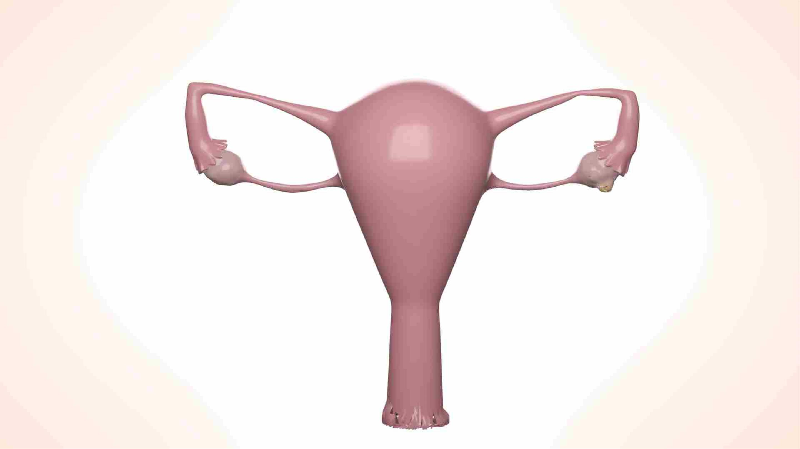

Slide 14
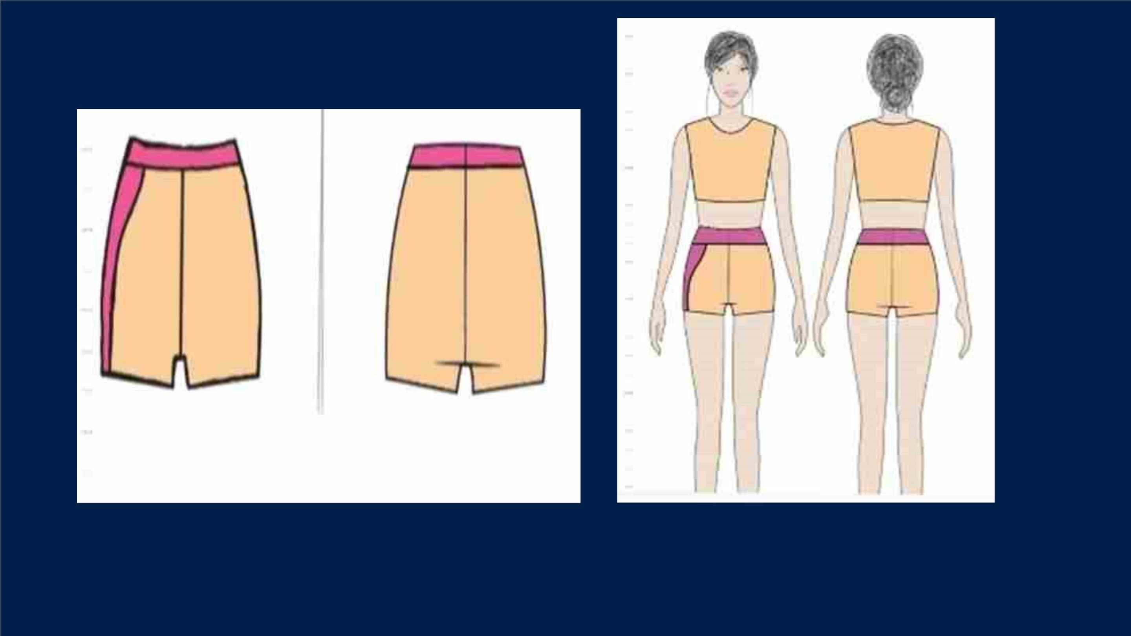
Des ign

Slide 15
FOLLOW UP P LAN
If everything goes well as we have planned to so we will try to launch the product befor
2024. As i had already mentioned that medical projects are time taking so it will tak
about 2-2½ years to complete this project. We also want our project to be complete
ASAP, but if we all want good result we have to wait and have patience.
Through these pie chart we can conclude that medical and healthcare are the top sellin
products all over the world. Our product will be the product that will detect cyst o
tumours at its early stage through a cycling shorts and alert them with the help of an ap
provided.

Slide 16
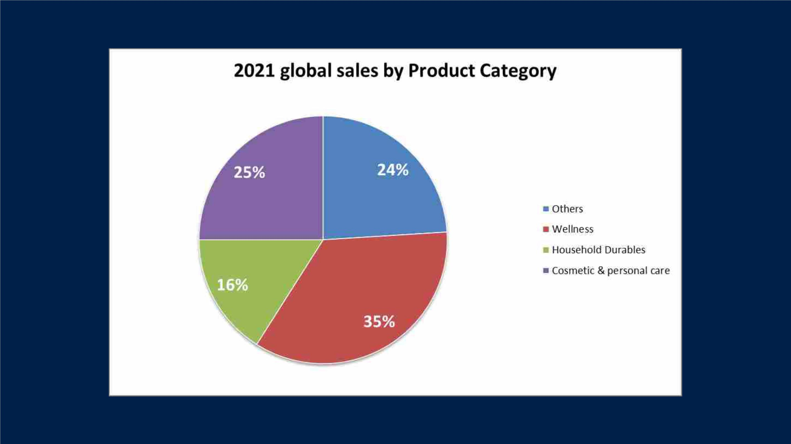

Slide 17
THA N K YOU!!

